Slide 1

Getting to know Azure Search
Andrei Dzimchuk | Software Developer

Slide 2

Andrei Dzimchuk | @dzimchuk
Works at ScienceSoft
Enjoys building solutions on Microsoft Azure
MCSD (Web) & MCPD (Web and Windows)
Runs an open source project at http://pvp.codeplex.com
Blogs at http://dzimchuk.net

Slide 3
Search
What’s on your mind?

Slide 4
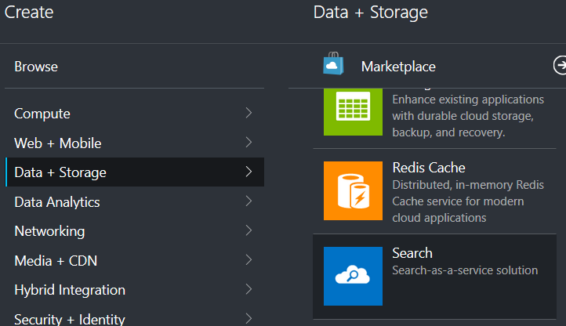
Creating a service
New-AzureResourceGroupDeployment -ResourceGroupName TestGroup '
-GalleryTemplateIdentity Microsoft.Search.1.0.8 '
-nameFromTemplate test '
-location "West Europe" '
-sku standard '
-replicaCount 1 '
-partitionCount 1

Slide 5
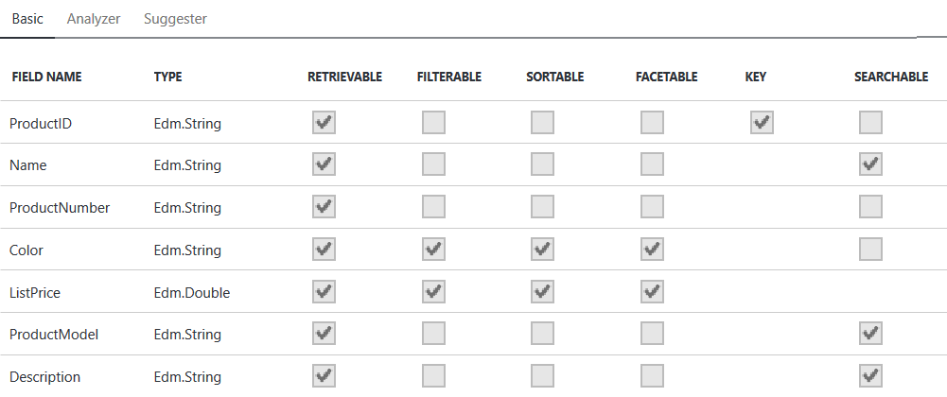
Index

Slide 6





Indexing (pull model)
Indexer
Pulls data
Pulls data
App services
On premise applications

Slide 7




Indexing (push model)
Index data
Index data
App services
On premise applications

Slide 8
Language analyzers
"Well!" thought Alice to herself "After such a fall as this, I shall think nothing of tumbling down-stairs!“
well | thought | alice | to | herself | after | such
a | fall | as | this | i | shall | think
nothing | of | tumbling | down | stairs
Lucene Standard:
well | thought | alic | to | herself | after | such
a | fall | as | this | i | shall | think
noth | of | tumbl | down | stair
Lucene English:
well | think | alice | to | herself | after | such
a | fall | as | this | i | shall | think
nothing | of | tumble | down | stair
Microsoft English:

Slide 9
Resources
Demo project and automation scripts: https://github.com/dzimchuk/azure-search
Great MVA course (where I borrowed the language analyzers comparison from): http://www.microsoftvirtualacademy.com/training-courses/adding-microsoft-azure-search-to-your-websites-and-apps
Azure Search Tool: https://github.com/MaxMelcher/AzureSearchTool
REST API Reference: https://msdn.microsoft.com/en-us/library/azure/dn798935.aspx

